Slide 1
K Nearest Neighbour
Supervised, non-parametric algorithm

Slide 2
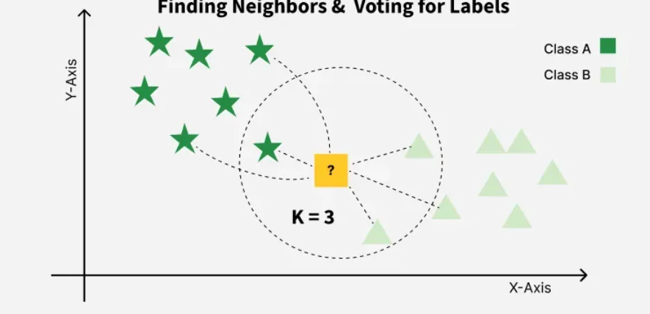
Logic
based on the idea that data points with similar features tend to have similar outcomes, so a new data point is classified or predicted by looking at the labels or values of its nearest neighboring data points in the feature space.

Slide 3


Pseudocode
Input: Training data (X_train, y_train), Test point x, K
For each data point in X_train:
Compute distance from x
Sort distances in ascending order
Select K nearest neighbors
If classification:
Return majority class
Else if regression:
Return mean of K neighbors

Slide 4
Why KNN?
KNN works on the simple idea that similar data points lie close to each other, so the output for a new data point can be predicted by analyzing the K nearest neighbors in the dataset. It does not build a separate training model; instead, it calculates distances between data points at the time of prediction and uses majority voting (for classification) or averaging (for regression) to produce results. This makes KNN intuitive and effective for problems where patterns are based on similarity.

Slide 5
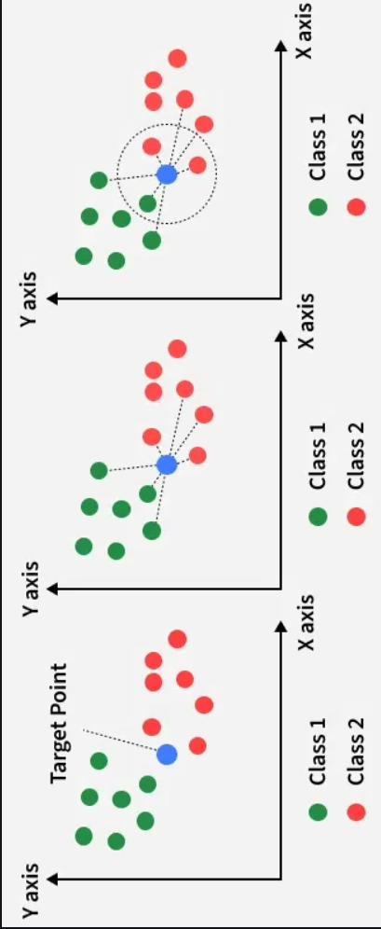
How KNN Works
Select the value of K (number of neighbors)
Calculate distance between test point and all training points
Sort distances in ascending order
Select the K nearest data points
Predict output based on:
Most common class (classification)
Mean value (regression)

Slide 6

Real-Time Use Case
Used in product and content recommendations
Finds users with similar preferences
Suggests items liked by similar users
Example:
Netflix movie recommendations
Amazon product suggestions
Works without building a complex predictive model

Slide 7
Pros of KNN
Simple and easy to understand
No training phase required
Works for both classification and regression
Adapts easily to new data
Effective for small datasets
Cons of KNN
Slow for large datasets
High memory usage
Sensitive to noise and outliers
Performance depends on correct K value
Requires feature scaling
Story for illustration purposes only

Slide 8

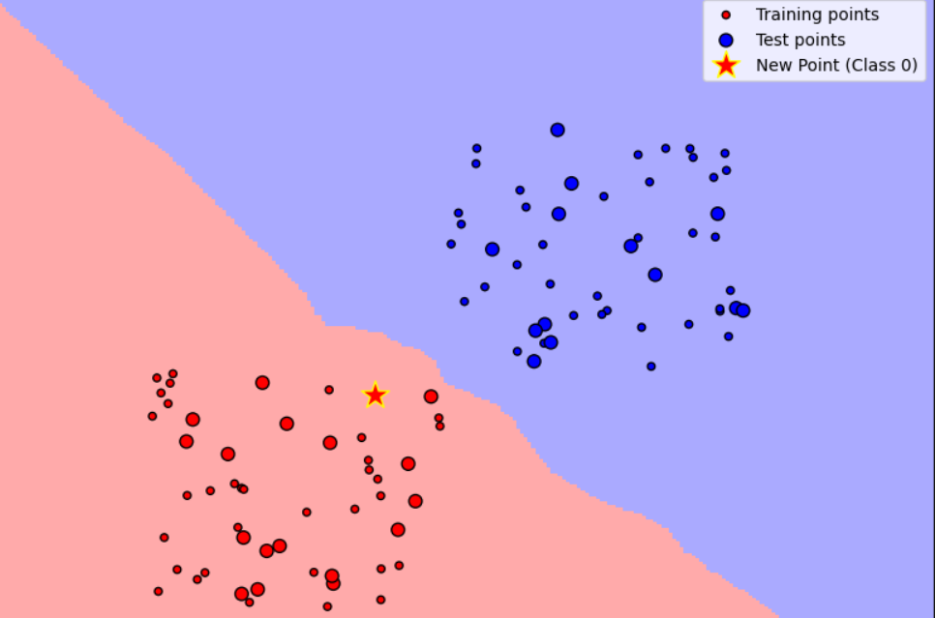
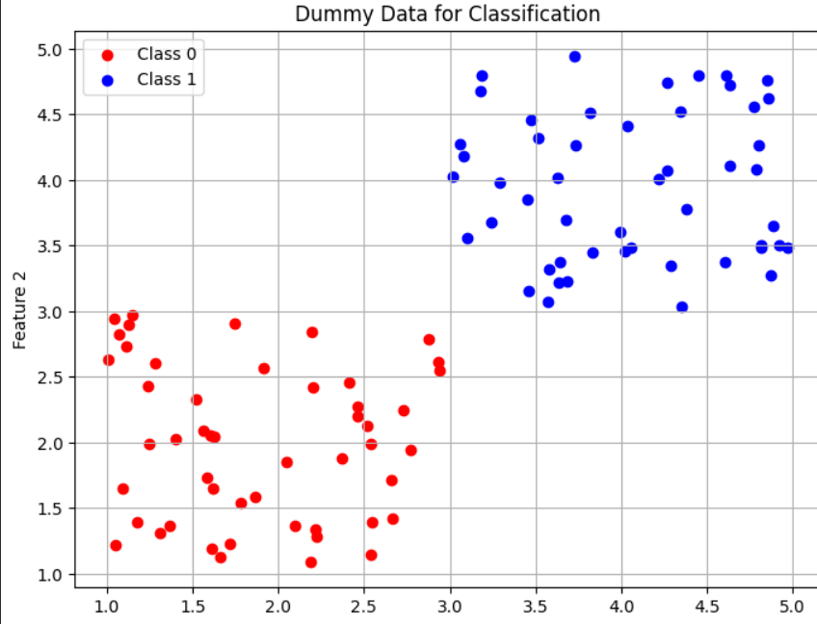
Task Output

